Slide 1
Scraping Reddit for Research
GitHub Repository
Last Updated January 2021
Billie Sun | bs676@cornell.edu
Notes:
intended more for qual researchers since scraped data is formatted for readability/qualitative analysis (not prioritizing efficiency/scalability)

Slide 2
Setting up the environment
Version control: GitHub
Keep revisions straight, store modifications in a central repository, allow for collaboration
Optional but highly recommended for larger projects
Code editor: Visual Studio Code
Download the latest version of Python 3 (Python 2 not suitable for scraping Reddit)
Optional: connect GitHub repository to Visual Studio Code (instructions)
Debugging APIs: Insomnia REST Client
Optional but highly recommended if you’re unfamiliar with APIs
Notes:
this part is going to be a pain if you don’t have these downloaded yet...so take your time and be patient!!

Slide 3
Getting started: everything you need to download
Required
Visual Studio Code
Python 3 (select “Add to PATH” during installation)
Python packages (type the following into the Visual Studio Code terminal)
“pip install PRAW”
“pip install PSAW”
“pip install pandas”
“pip install requests”
Optional
GitHub
Connect GitHub repository to Visual Studio Code (instructions)
Insomnia REST Client
No technical experience required! Just makes working with APIs (e.g. Pushshift API) easier
Notes:
do all of this before trying to run any of the reddit-scraper code
note that GitHub isn’t the most beginner friendly (best for larger coding projects with multiple collaborators)--skip this if you’re new
type “pip install [package name]” in VS Code terminal to download the Python package--some are already included when you download Python, but the ones listed in this slide aren’t

Slide 4
Accessing Reddit Data
Reddit API
Typically accessed via PRAW (Python Reddit API Wrapper)
Python package that directly accesses Reddit’s API (most up-to-date)
Great for fairly new submissions and comments since PRAW is up-to-date
Slower--more limitations on speed and amount of data you can scrape
Limited search functionality (similar to existing Reddit search function)
Pushshift API
Third-party Reddit dataset (under active development)
Data is copied into Pushshift at the time it’s posted to Reddit (may not be updated)
Better for analyzing older data since Pushshift may not reflect recent changes
Faster--can scrape large quantities of Reddit data more quickly
Extensive search functionality (can search comments) and summary data
Notes:
when using PRAW, need Reddit authorization (see below; no credentials needed for Pushshift)
if providing username/password, you can scrape from private subreddits your Reddit account has access to
(otherwise username/password not needed for PRAW)
be sure to fill out this part in the code with your Reddit credentials (instructions here):
# load Reddit authentication for PRAW (not necessary if only using Pushshift)
# reference: https://www.storybench.org/how-to-scrape-reddit-with-python/
reddit = praw.Reddit(client_id='PERSONAL_USE_SCRIPT_14_CHARS',
client_secret='SECRET_KEY_27_CHARS',
user_agent='YOUR_APP_NAME')

Slide 5
Helpful resources
Reddit API
Reddit API documentation
PRAW documentation
r/redditdev for questions
Reddit API access rules
Walkthrough: How to scrape Reddit with Python
Walkthrough: PRAW Tutorial for Windows
Pushshift API
Pushshift documentation
r/Pushshift FAQ for questions
User-friendly Pushshift interface (no code)
Research paper: The Pushshift Reddit Dataset (Baumgartner et al., 2020)
Walkthrough: Using Pushshift’s API to extract Reddit Submissions
Notes:
number of peer-reviewed research papers published using Pushshift data are growing quickly!
~30 papers in 2018 and ~60 papers in 2019 (source)
for more specific questions, refer to the dedicated subreddits

Slide 6
Using PRAW and Pushshift together
Necessary for balancing quality & quantity of Reddit data
Pushshift helps scrape large quantities of data more efficiently (1000+ posts)
PRAW ensures fluid attributes (e.g. scores, awards, recent deletions) are up-to-date
Notes for researchers
Pushshift scores (particularly comment scores) may NOT be accurate; update with PRAW
When using Pushshift for research, always set metadata = true and check that all data is being collected properly
PSAW helps incorporate PRAW into Pushshift and works around scraping limits
Notes:
PSAW (Python Pushshift API Wrapper) is more beginner-friendly, but it may be harder to find resources online since it’s relatively new (created 2018). I used it for convenience in comments_to_csv.py and it worked well!

Slide 7
Accessing the Pushshift API
Access Pushshift data by adding parameters to the end of this base URL: https://api.pushshift.io/
Search comments: https://api.pushshift.io/reddit/search/comment/
Search submissions: https://api.pushshift.io/reddit/search/submission/
Example: search for the most recent Reddit submissions mentioning the word "science" in the title or selftext
https://api.pushshift.io/reddit/search/submission/?q=science
Pushshift only returns 25 posts by default (see next slide)
Notes:
you can directly access the Reddit API by building a URL this way too! but PRAW handles that URL-building process for you and makes it cleaner

Slide 8
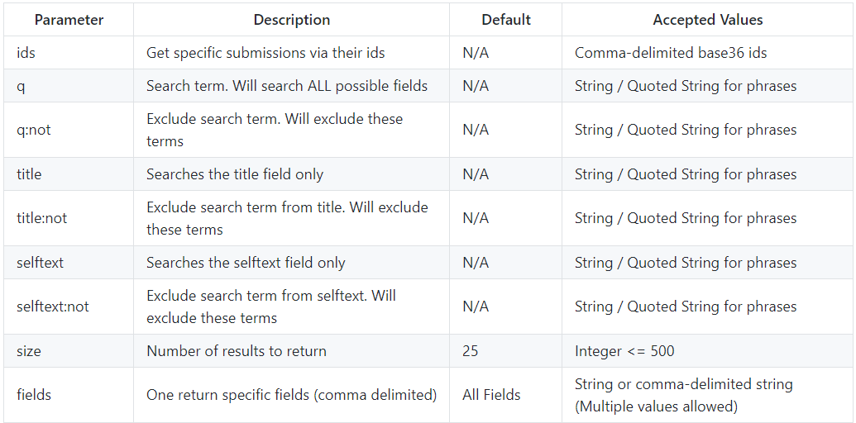
See Pushshift documentation for all possible parameters you can add to the https://api.pushshift.io/ base URL

Slide 9
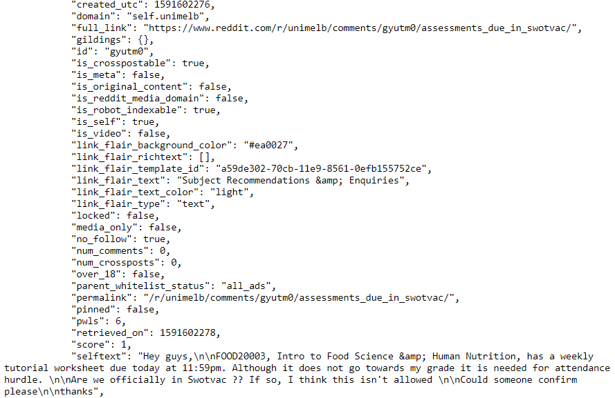
What does Pushshift data look like?
Follow the link below and see for yourself!
https://api.pushshift.io/reddit/ search/submission/?q=science
Optional: use Insomnia REST Client to improve readability and organize different URLs
Notes:
similar to https://scholar.google.com/scholar?q=crowdwork

Slide 10
Analyzing Reddit Posts
posts_to_csv.py code
(outputs to data > scraped_posts folder)

Slide 11
Overview of posts_to_csv.py code
Import Python packages
pip install PRAW, pandas, and requests if getting ImportError
Load credentials for PRAW
Build Pushshift URL to search Reddit submissions (see next slide)
Paginate results to work around Pushshift’s size limit
Clean/format data and update scores with PRAW for more up-to-date stats
Export scraped data to csv file(s) in scraped_posts folder

Slide 12
Example Pushshift request
https://api.pushshift.io/reddit/search/submission/
?q=bias|prejudice
scraping posts with “bias” or “prejudice” in the title or selftext
&subreddit=AskSocialScience,AskFeminists
&fields=id,score,full_link,subreddit,title,selftext,created_utc,author,num_comments
&size=100
paginating results works around this limit
&after=1546300800
only scraping posts after 12am on 1/1/19 Unix time
&sort=desc
must sort by desc if scraping more than 1000 posts
&metadata=true
&aggs=subreddit,author
Notes:
(this exact request should only take 1-2 minutes to scrape using posts_to_csv.py)
be careful with syntax when specifying multiple keywords:
‘bias|prejudice’ => bias OR prejudice
‘bias+prejudice’ => bias AND prejudice
‘“gender bias”|prejudice’ => “gender bias” OR prejudice (use quotes to specify keyword order)
&sort=desc (most recent posts first) is the Pushshift default--necessary for paginating results to prevent scraping redundant data

Slide 13
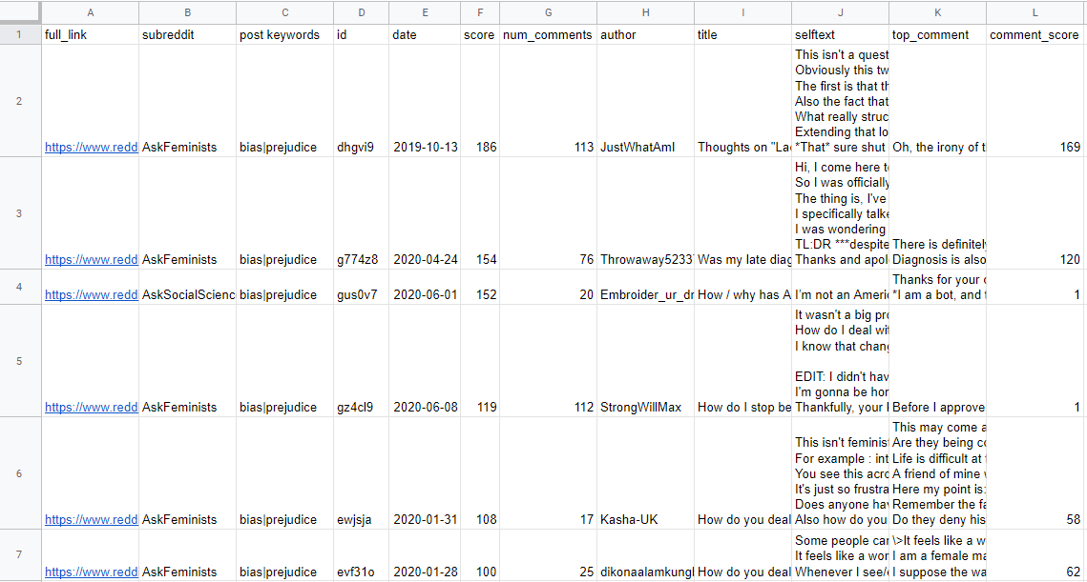
scraped_reddit_posts.csv in Google Sheets--manually add columns to the right to hand code posts for relevance, themes, etc.

Slide 14
Analyzing Reddit Comments
(Qualitative Research Only)
comments_to_txt.py code (outputs to data > qual_comment_analysis folder)

Slide 15
Suggested workflow for qualitative researchers
Scrape desired posts using posts_to_csv.py code
Add hand coded observations about posts by creating new columns
e.g. relevance-researcher1, relevance-researcher2, relevance-reconciled columns
Save edited spreadsheet and manually add to qual_comment_analysis folder
Modify filter_criteria variable in comments_to_txt.py
Dictates which specific Reddit posts to show comments for (must limit for qual analysis)
e.g. when relevance-reconciled column value equals 1 (show comments for “relevant” posts)
Run comments_to_txt.py and read through selected_reddit_comments.txt (exported file) to qualitatively analyze Reddit comments

Slide 16
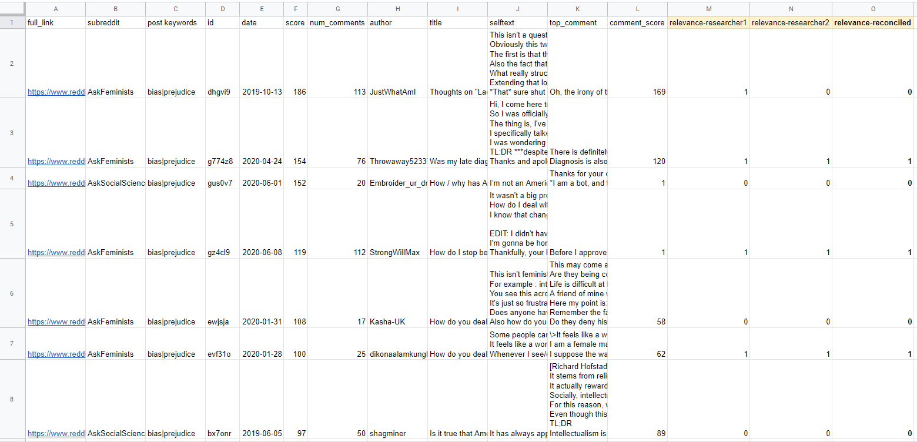
Example of how manually_coded_posts.csv can be set up before feeding into comments_to_txt.py code for qualitative comment analysis
Notes:
it’s better to manually specify which posts you want to display comments for since the exported txt file will be unnecessarily large otherwise
(you can still use comments_to_txt.py to display comments for every single scraped post, but you won’t be able to read/analyze most of it)

Slide 17
Overview of comments_to_txt.py code
Import Python packages and load credentials for PRAW
Filter manually_coded_posts.csv in qual_comment_analysis folder by desired criteria
e.g. post_data['relevance-reconciled']==1 (show comments for “relevant” posts)
Use PRAW to traverse comments as they appear on Reddit (e.g. by Top, New, etc.) and write to selected_reddit_comments.txt file
Tabulate comments mirroring Reddit’s nested structure for readability
Notes:
PRAW is absolutely necessary to ensure comments appear in a readable order

Slide 18
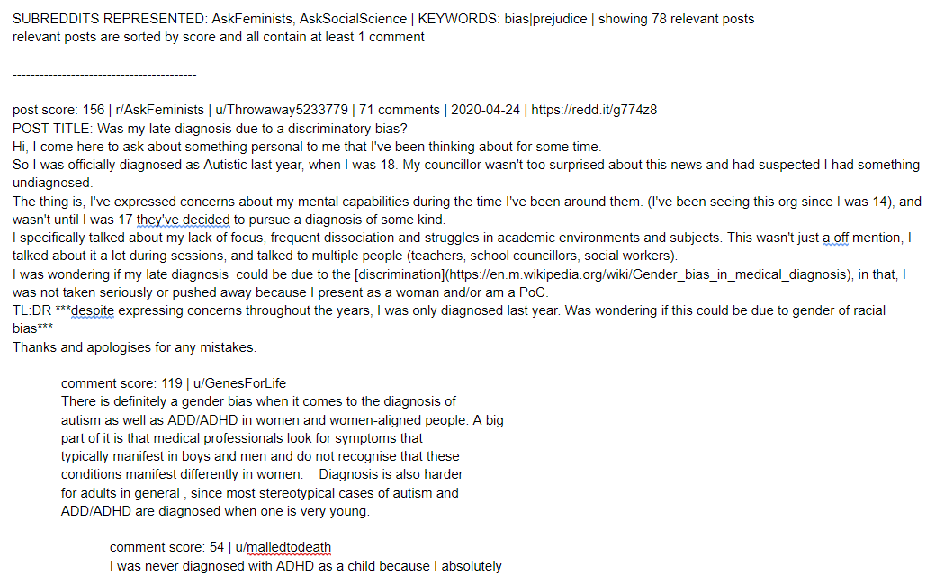
selected_reddit_comments.txt scraped comments in Google Docs--manually add comments/annotations to analyze for themes

Slide 19
Analyzing Reddit Comments
(General Purpose)
comments_to_csv.py code (outputs to data > scraped_comments folder)

Slide 20
Help me improve this script!
I added comments_to_csv.py to the scraper after receiving a few emails asking how to modify posts_to_csv.py to export comments
Thank you to those who reached out!
Since posts_to_csv.py can NOT be easily modified to export comments, I wanted to provide a starting point for analyzing comments on a larger scale
Please email me at bs676@cornell.edu with questions or feedback regarding comments_to_csv.py and I’ll start adding more slides based on community input :)

Slide 21
Final Notes
Avoid revealing usernames and other personally identifiable information if not given permission; paraphrase as much as possible
Stories of pain and trauma (e.g. #BlackintheIvory) should not be scraped and exploited for personal gain (@katsch0)
Read, reflect, and understand instead
Never use scraped data to stalk or harass others
Pushshift disabled author search due to this issue
Consider donating to Pushshift if you found it useful
Thanks to Jason Baumgartner (u/Stuck_In_the_Matrix) and other volunteers for creating and maintaining this resource!
Notes:
email me at bs676@cornell.edu if you have any questions or comments!!

